Slide 1
Computer Networks and Internets
《计算机网络与因特网》课件
林坤辉

Slide 2
PART IV Internetworking
Chapter 23 （2）
An Error Reporting Mechanism(ICMP)
差错报告机制(ICMP)

Slide 3

23.2 Best-Effort Semantics and Error Detection
“尽力而为”语义和差错检测
IP Datagrams can be lost, duplicated, delayed, or delivered out of order.
IP attempts to avoid errors and to report problems when they occur.

Slide 4
23.3 Internet Control Message Protocol互联网控制报文协议
The TCP/IP suite includes a protocol that IP uses to send error messages when conditions such as the one described above arise.
ICMP: Internet Control Message Protocol.
The protocol is required for a standard implementation of IP.
IP uses ICMP when it sends an error message, and ICMP uses IP to transport messages.

Slide 5
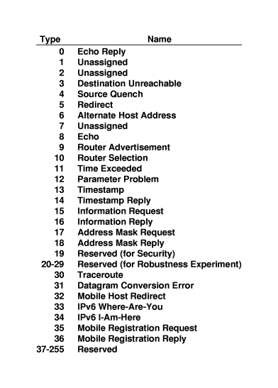
ICMP 信息列表

Slide 6
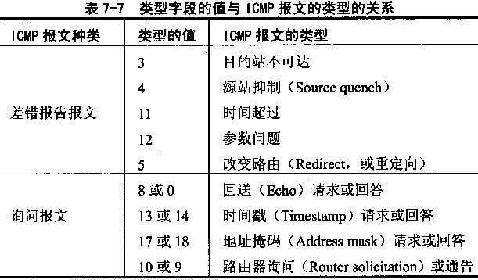

Slide 7
Examples of ICMP error messages:
Source Quench(源抑制):
Time Exceeded(超时).
Destination Unreachable(目的不可达)
Redirect(重定向).
Parameter Problem(参数问题)

Slide 8
Examples of ICMP informational messages:
Echo Request/Reply(回应请求/应答).
Address Mask Request/Reply(地址屏蔽码请求/应答)

Slide 9
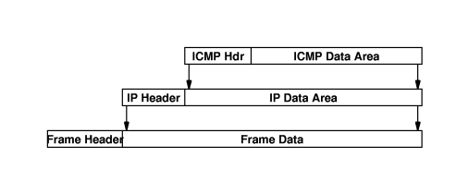
23.4 ICMP Message Transport
ICMP uses IP to transport each error message.
The ICMP message is placed in the data area of the IP datagram.

Slide 10
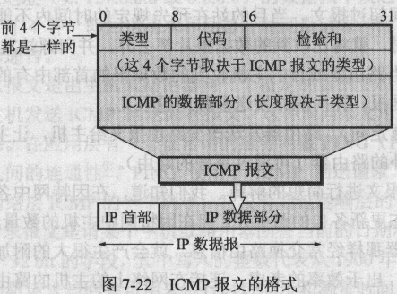

Slide 11
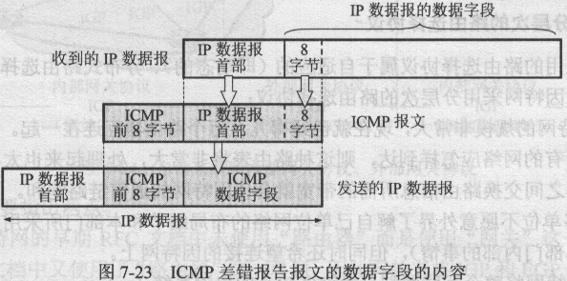

Slide 12
23.5 Using ICMP Message To test Reachability
用I C M P报文测试可达性
Ping program uses the ICMP echo request and echo reply messages.
Ping sends an IP datagram that contains an ICMP echo request message to the specified destination.
Whenever an echo request arrives, the ICMP software must send an echo reply.

Slide 13
23.6 Using ICMP To Trace A Router用I C M P跟踪路由
Each router that handles a datagram decrements the TIME TO LIVE counter in the header.
If a counter reaches zero, the router discards the datagram and sends an ICMP time exceeded error back to the source.
Traceroute program simply sends a series of datagram and waits for a response to each.

Slide 14
23.7 The last Address printed by Traceroute
Traceroute continues to increment the TIME TO LIVE until the value is large enough for the datagram to reach its final destinaation.
Send an ICMP echo request message; the destination host will generate an ICMP echo reply.
Send a datagram to a nonexistent application; the destination host will generate an ICMP destination unreachable message.

Slide 15
23.8 Using ICMP For Path MTU Discovery
In a router, IP software fragments any datagram that is larger than the MTU of the network over which the datagram is being transmitted.
The smallest MTU along a path from a source to a destination is known as the path MTU.
The error message consists of an ICMP message that reports fragmentation was required but not permitted.

Slide 16
作业
ICMP对IP数据传输采取了哪些控制措施？
理解TraceRoute和PING的原理。
考虑如何利用ICMP协议对一个网络上的时延性能进行监控？

